Slide 1
PREDICTING THE OPERATIONAL STATUS OF WATER ACCESS POINT IN TANZANIA

Slide 2

INTRODUCTION
Access to clean and functional water sources is a fundamental necessity, yet many regions in Tanzania struggle to provide reliable water points for their population of over 67 million. Despite numerous water points being established across the country, a significant number are either non-functional or in need of repair. This situation hampers access to clean water, leading to health challenges, time lost in fetching water, and increased burdens on communities, particularly women and children

Slide 3

INTRO CONTS….
This project seeks to address this issue by building a machine learning model to classify the operational status of water points. By analyzing data related to water point features such as pump type, installation details, and geographic characteristics, the project aims to predict whether a water point is functional, functional but requiring repair, or non-functional. Such insights can empower stakeholders to take targeted and proactive actions to improve water access.​​

Slide 4

PROBLEM STATEMENT
In Tanzania, many water points fail to provide reliable access to clean water, impacting millions of people and burdening rural communities. As a data scientist, my goal is to develop a machine learning model to predict the operational status of water points—functional, in need of repair, or non-functional. This will enable stakeholders to prioritize maintenance, allocate resources effectively, and address systemic issues, ensuring sustainable access to clean water for the population.

Slide 5

OBJECTIVES
Predict Water Point Functionality: Develop a machine learning models to classify water points as functional, functional but in need of repair, or non-functional.​
1
Evaluate Model Performance: Assess the accuracy, precision, recall, and overall effectiveness of the models to ensure reliable predictions.​
2

Slide 6
OBJECTIVES CONTS…
3
Identify Failure Patterns: Analyze the data to uncover factors and trends contributing to water point failures.​
Optimize Resource Allocation: Provide actionable insights for stakeholders to prioritize maintenance and repair efforts effectively.
4

Slide 7
DATA
Source: The dataset was sourced from Taarifa and the Tanzanian Ministry of Water and is available on DrivenData. https://www.drivendata.org/competitions/7/pump-it-up-data-mining-the-water-table/page/23/
Features: The dataset includes attributes such as amount_tsh, funder, gps_height, installer, longitude, latitude, region, management, permit, construction_year, and more.
Target Variable: status_group (categorical: functional, functional needs repair, non-functional).

Slide 8

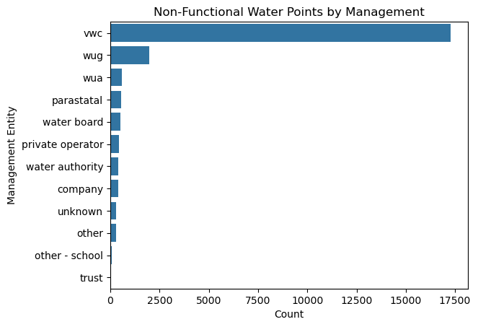

Slide 9
OBSERVATIONS
VWC (Village Water Committees): This entity accounts for the majority of non-functional water points, indicating potential challenges in maintenance or resource allocation.Investigate the capacity, training, and resources available to VWC. Provide targeted training or support to improve their management effectiveness.
WUG (Water User Groups):The second-highest number of non-functional water points is managed by WUG.Evaluate their management processes and identify gaps that lead to failure.

Slide 10
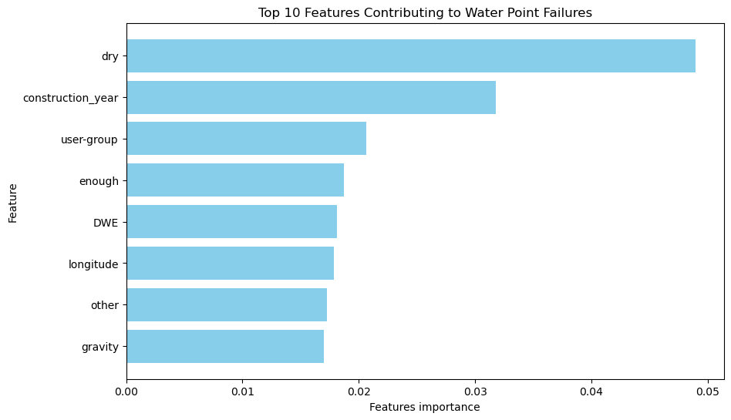

Slide 12


Slide 13
competition
Convenient
Contoso
A
Expensive​
Affordable
B
D
E
C
Inconvenient​

Slide 14
Growth strategy
How we’ll scale in the future​
Feb 20xx
May 20xx
Oct 20xx
Release the app to the general public and monitor press and regional market trends
Gather feedback from the start up community to expand availability of the product

Slide 15
Traction
Forecasting for success​
Key Metrics
Revenue by year
 | clients | orders | Gross avenue | Net revenue
20XX​ | 10​ | 1100​ | $10,000​ | $7,000​
20XX​ | 20​ | 200​ | $20,000​ | $16,000​
20XX​ | 30​ | 300​ | $30,000​ | $25,000​
20XX​ | 40​ | 400​ | $40,000​ | $30,000

Slide 16
Two-year action plan
Run focus groups​
Gather feedback​
Jan
eb
Mar
Apr
Jun
Jul
Aug
Sep
Oct
Nov
Dec
Test with start ups​
Regional launch​
Deliver to consumers​
20XX
Jan
Feb
Mar
Apr
May
Jun
Jul
Aug
Sep
Oct
Nov
Dec

Slide 17
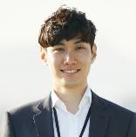

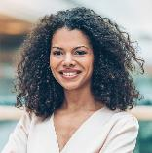
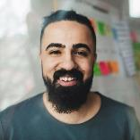
Meet the team
Takuma Hayashi​​
Mirjam Nilsson​​
Flora Berggren​​
Rajesh Santoshi​​
President​
Chief Executive Officer​
Chief Operations Officer​
VP Marketing​

Slide 18








The Full team
Takuma Hayashi​
Mirjam Nilsson​​
Flora Berggren​​
Rajesh Santoshi​​
President​
Chief Executive Officer​
Chief Operations Officer​
VP Marketing​
Graham Barnes​
Rowan Murphy​
Elizabeth Moore​
Robin Kline​
VP Product​
SEO Strategist​
Product Designer​
Content Developer​

Slide 19
Funding
$12K
$14K
$32K
$82K
Campaigns
Angel investments
Cash
Shares
Revenue obtained from online campaigns and reorders
Amount obtained through other investors​
Liquid cash we have
on hand​
Number of shares converted into USD​

Slide 20

Summary
At Contoso, we believe in giving 110%. By closing the loop on task management and using the latest technology, we help businesses grow and nurture a consumer-first mindset. We thrive because of our market knowledge and a great team behind our product. As our CEO says, "Efficiencies will come from proactively transforming how we do business."

Slide 21

Thank you
Mirjam Nilsson​​
206-555-0146​
mirjam@contoso.com​
www.contoso.com​

